Slide 1
In-Class Activity
Class 02A
Block Diagram Basics

Slide 2
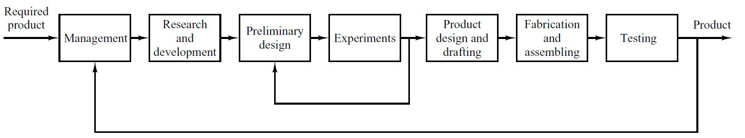
In-Class Activity: Block Diagram Basics
Figure 1: Block diagram of a generalized production process from Modern Controls Engineering (Ogata, 2010)
What is a block diagram?
It is a 10,000 foot view of a system. A visual aid to show how the various components of a system work together and which parts are connected to each other.
Why are they important/how do we use them in engineering?
Quickly and visually provide an overview of the system
Eliminate the “black box” idea to a system of something goes in and something else comes out and its magic how it transformed
Increased understanding and knowledge of the parts that are comprised in the system.

Slide 3
In-Class Activity
Class 02A
TI Kit Basics

Slide 4
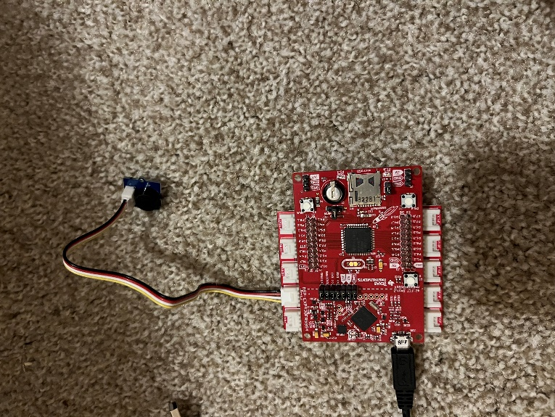
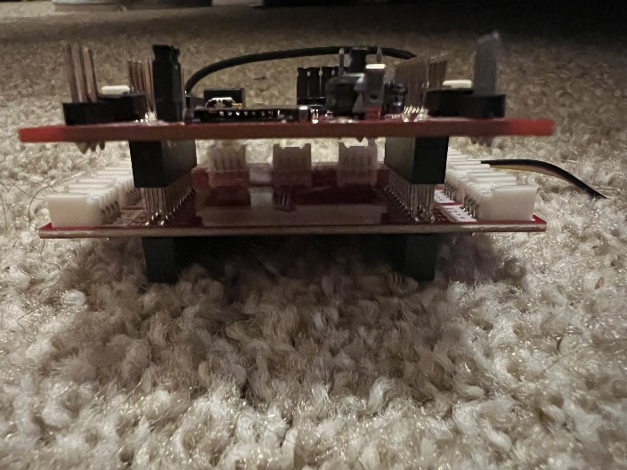
In-Class Activity: TI Kit Basics
Goal: To familiarize yourselves with how to upload code to the TI Kits and how its components piece together
Figure 3: Top View of Boosterpack to TI Kit Connection
Outcomes/Expected Results:
Upload a simple script to the TI board
Make the built-in LED blink
Open a serial port to continuously receive data
Connect the booster pack
Connect a buzzer to play a song
Figure 2: Side View of Boosterpack to TI Kit Connection

Slide 5
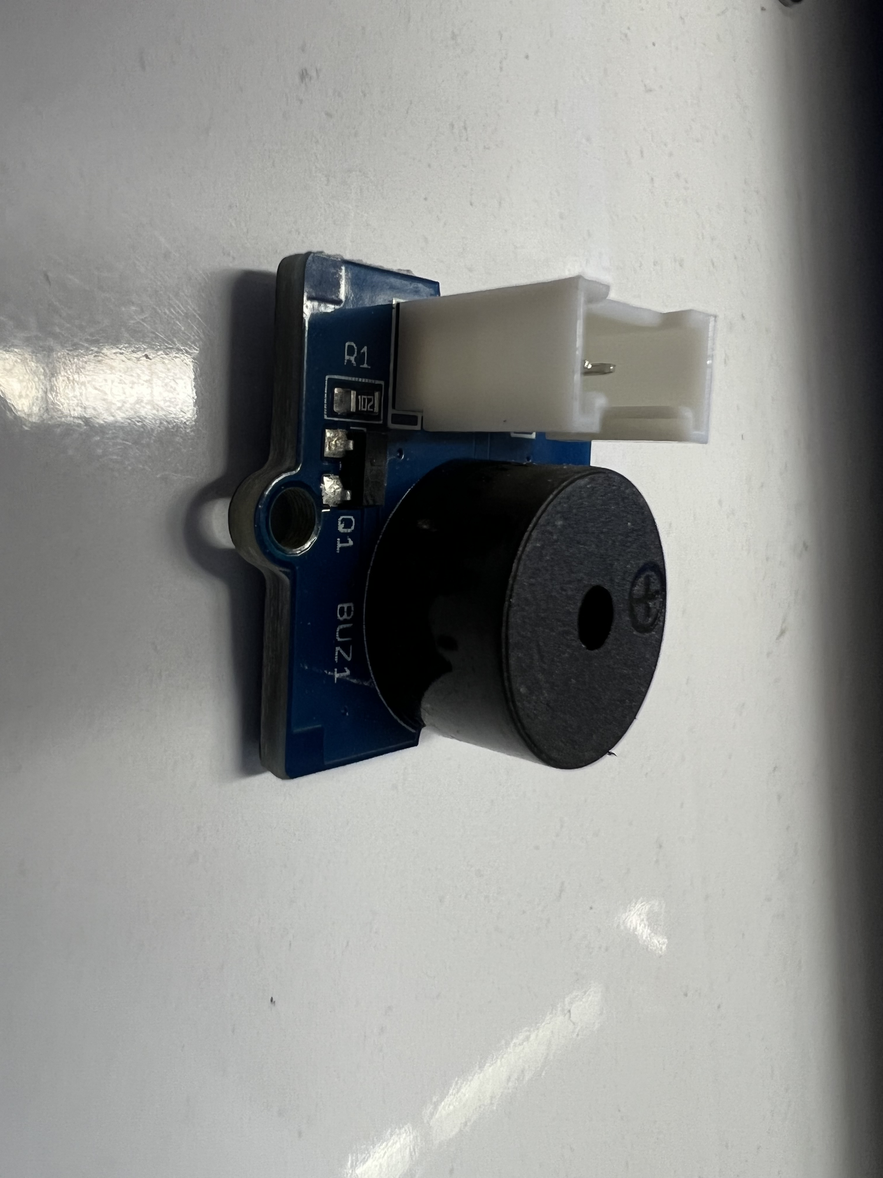
In-Class Activity: TI Kit Basics
Equipment List:
TI Kit Microcontroller
TI Kit Boosterpack
USB A to Micro USB Powercable
1x Four Prong Connector Cable
Grove Starter Kit Buzzer
Figure 4: Grove Starter Kit Buzzer

Slide 6
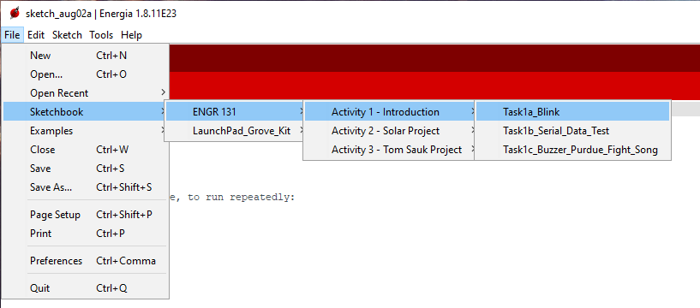
In-Class Activity: TI Kit Basics
Task 1a: Uploading a Sketch to the TI Kit Board
Open the Sketchbook/ENGR 131/Activity 1 - Introduction/Task1a_blink file in Energia.
If you don’t see the ENGR 131 folder in your sketchbook options, please see the Getting Started page for download and instructions.
Compile and upload the Blink sketch to your TI Kit.
HINT: If this works, two lights should be illuminated on your TI Kit.
Create a block diagram of the TI Kits
Take a picture of the blinking TI Kit and add it to your ICA answer sheet
Figure 5: TI Kit Basics Filepath Example through Sketchbook

Slide 7
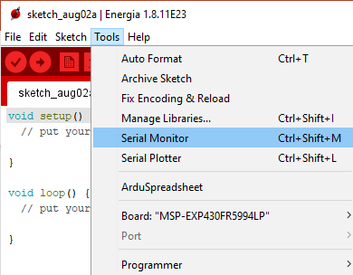
In-Class Activity: TI Kit Basics
Task 1b: Uploading a Sketch to the TI Kit Board
Open the Sketchbook/ENGR 131/Activity 1 – Introduction/Task1b_Serial_Data_Test file in Energia.
Compile and upload the Serial_test sketch to your TI Kit.
Open the Serial Monitor located in the Tools Menu to complete question 2.
Close the Serial Monitor and open the Serial Plotter located in the Tools Menu to complete question 3.
Draw a block diagram of the TI Kit set-up
Take a screenshot of the serial monitor once 25 data points have been collected and add it to your ICA answer sheet.
Take a screenshot of the serial plotter once 100 data points have been plotted and add it to your ICA answer sheet
Figure 6: Serial Monitor Location

Slide 8
In-Class Activity: TI Kit Basics
Task 1c: Basic Circuit with the TI Kit
Open the Sketchbook/ENGR 131/Activity 1 – Introduction/Task1c_Song file in Energia.
Before compiling and uploading the sketch, first you need to add to the board.
Connect the Grove Starter Kit Buzzer to J14 of the Boosterpack using the four-prong connector cable.
Connect the Boosterpack underneath the TI Kit board.
Upload and compile the Task1c_Song file.
Draw a Block Diagram of your Set-up
Record a sound clip of your buzzer playing the song and upload it along with ICA answer sheet.
Figure 2: Top View of Boosterpack to TI Kit Connection

